Slide 1
Water Level Estimation for Vehicles Submerged in Flood Water
Notes:
Hello, Good morning, everyone, I’m Jianqi Sun, thanks for coming to my master thesis final presentation. My topic is Water Level Estimation for Vehicles Submerged in Flood Water.

Slide 2
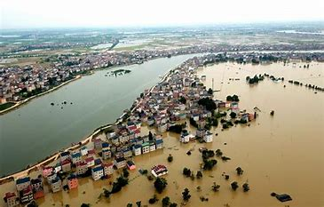
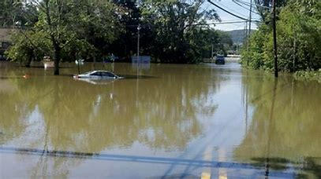
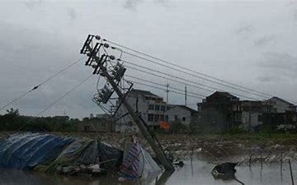
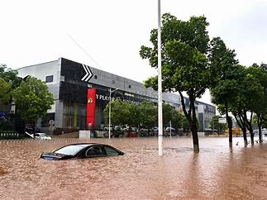
Background
Floods in Henan in 2021
Inundated road
Source:https://www.henan100.com/d/file/news/gn/now/20200719/6b548e5673ef720a0ab8c04e2e29e2b3.jpg
Source:https://699pic.com/image/3942644.html
Disruption of the transportation system
Damage to infrastructure
Source:https://www.youuav.com/shop/986/news/newsid-284.html
Source:http://zazhi.qunba.com/wenzhang/1313021
Notes:
Flood disasters are now frequent. Therefore, accurate estimation of the water level helps to judge the rise /’raiz’/ of the flood to avoid more damage.

Slide 3
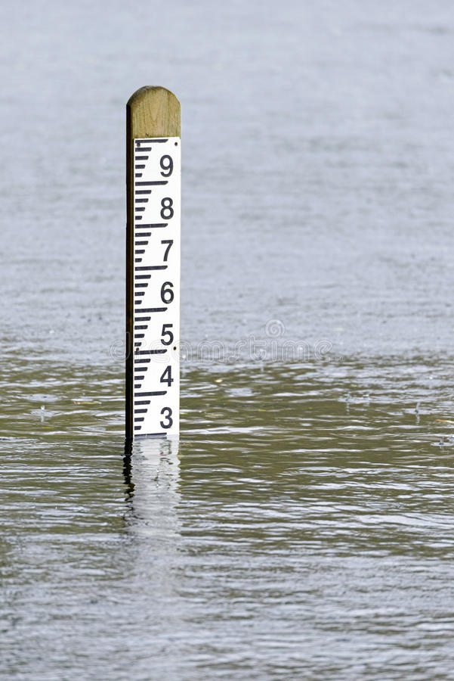
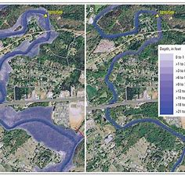
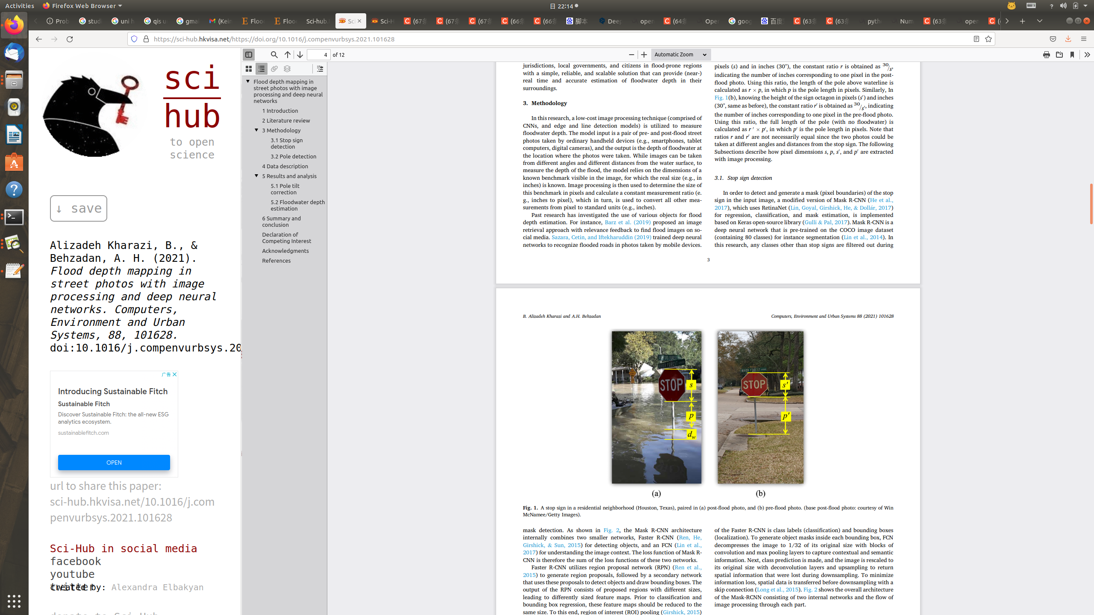
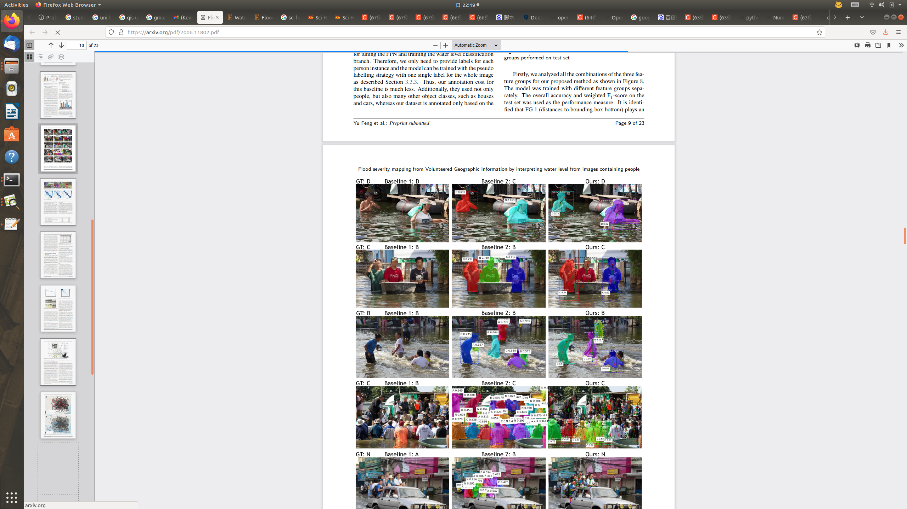
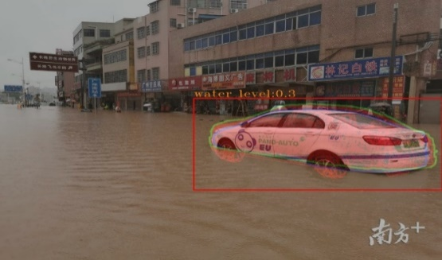
Motivation
1. Measuring water levels with contact and non-contact type gauges
2. Flood inundation maps and digital elevation models
3. Image processing and computer vision-based methods
Source：https://www.quanjing.com/imgbuy/ul0220-4772.html
Source: http://www.usgs.gov/news/3d-elevation-%E2%80%93-we%E2%80%99ve-got-you-covered-all-50-states?qt-news_science_products=2
Kharazi et al. 2021
Feng et al. 2020
This work
Notes:
There are mainly three methods for water level estimation as show here. The first picture shows the water level measured by contact or non-contact gauges. The second picture, for example, analyzes the extent of flood spread by satellite maps. As a result, image-based measurement methods are now of great interest. This method is mainly based on targets with similar appearance that are flooded. For example, traffic signs, submerged pedestrians and cars. As shown in the last picture, the result is obtained by my method, and this model is based on the car as the reference system.

Slide 4
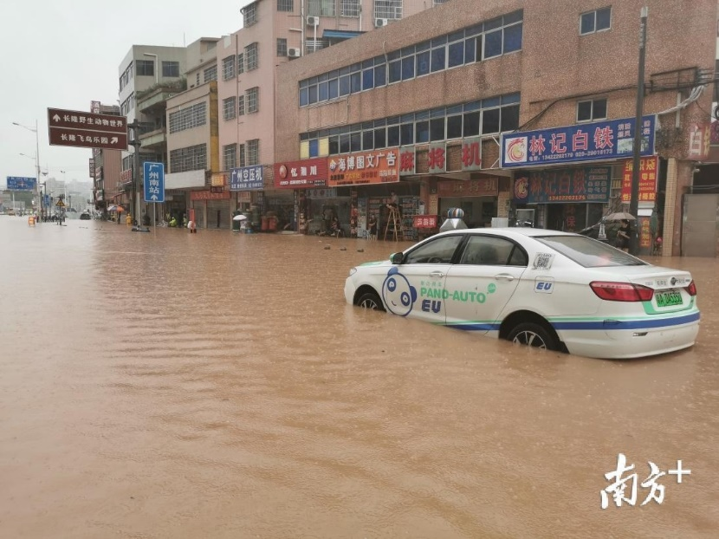
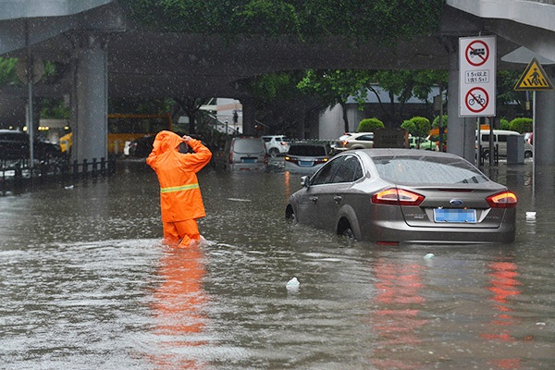
The goal of this work
Goal:
Estimation of water depth by submerged cars on 2D images of any size and resolution.
Source:https://new.qq.com/notfound.htm?uri=http://new.qq.com/omn/20190624/20190624A0OJ51.html?pc
Source:https://www.163.com/dy/article/DK42R2F70512E5AP.html
Notes:
In short, our goal is Estimation of water depth by submerged cars on 2D images of any scale and resolution.

Slide 5
Main Steps
1. Extract submerged vehicles
Purpose: Detect the part of the car that is above the flood water by Mask-RCNN and generate Mask.
Input: 2D images with submerged cars.
Output: Masks of each car and bounding boxes.
2. Pose estimation
Purpose: Obtain 3D pose information (translation and rotation) for each car.
Input: Car instance, 3D Models.
Output: Keypoints, bounding box, class and pose information of each car.
3. Water level estimation.
Purpose: Based on the pose information, the 3D model is reprojected to the 2D image to determine the depth of the car submerged by the flood and estimate the water level.
Input: Pose information, Mask and 3D Model
Output: Water level
Notes:
These are the main 3 steps as shown here

Slide 6
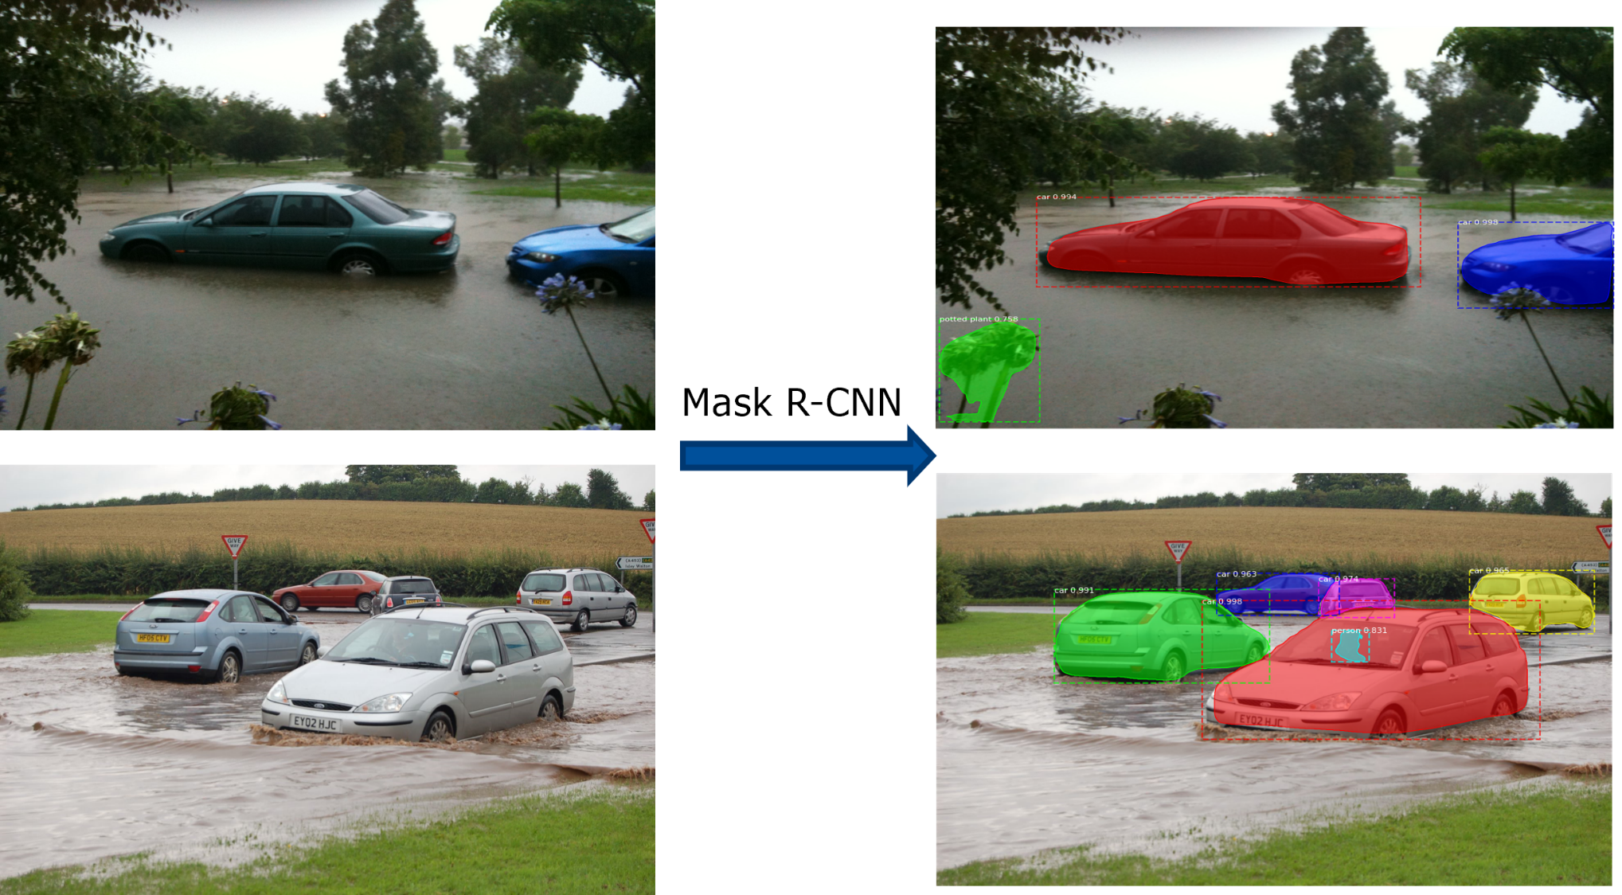
Step1 – Mask-RCNN
Pretrained on COCO dataset
Notes:
First step is about maskrcnn. There are many pretrained model resources of maskrcnn that achieve good detection, so there is no retraining of the model and we use the model trained by coco dataset. For example here, the 2D image is fed into the pre-trained model to get the mask and bounding box of each car.

Slide 7
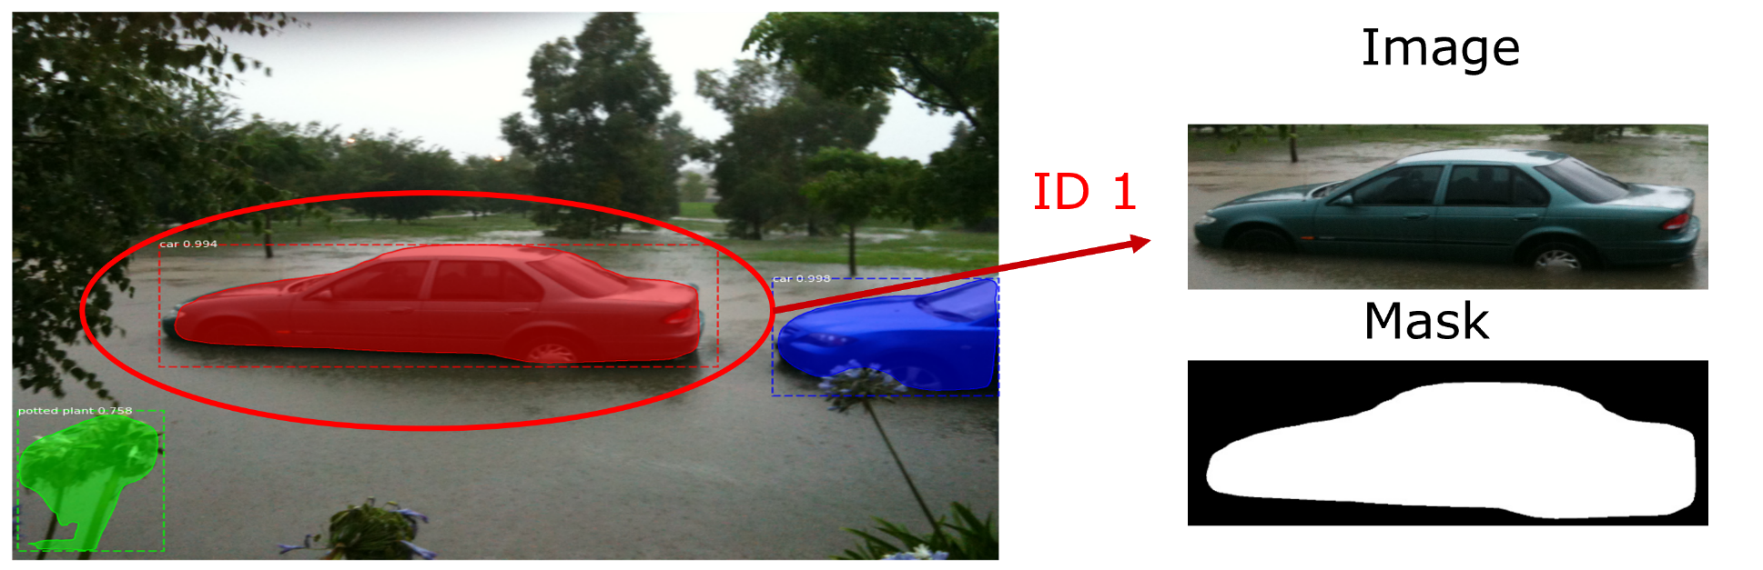
Step 1 – Mask R-CNN Extract submerged vehicles
Extract the car and mask according to the bounding box
Assign ID
Notes:
We only need to extract the objects and masks with the class of car by bounding box and assign the ID to them.

Slide 8
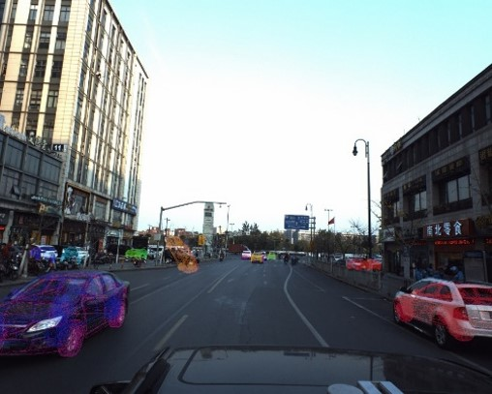
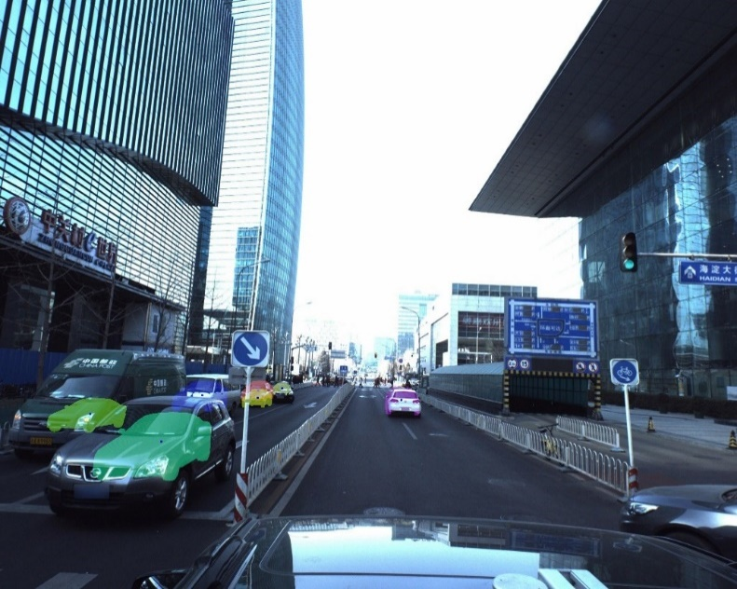
Step 2 - Car pose estimation
Pose estimation
Get 6 DoF pose information of the car from 2D image
Three attempts
End-to-end, direct output of pose information through neural networks, Keypoint R-CNN + fusion heads. (GSNet)
End-to-end, direct output of centroid and rotation information in the image coordinate system through neural networks. (Center-Resnet50)
Car keypoint detection (KeypointRCNN) + pose estimation using PnP (Perspective-n-Points)
加图片
Notes:
Next step is pose estimation. The purpose of pose estimation is to obtain the relative pose between the Camera and the 3D model. Therefore, finding the accurate pose information is the key to this step. Here I made three different attempts. First use an end-to-end network to get pose information. The main idea is to use keypoint r-cnn and fusion different heads to estimate the pose. The second one is not get the pose information in the world coordinate directly, but get the centroid in the image coordinate system and use this to calculate the pose information in the world coordinate. However, these two methods have been tested and found to be difficult to ensure the accuracy of pose and scale information, and therefore cannot accurately estimate the water depth. The third one is that Keypoints are detected by KeypointRcnn like gsnet, and then find the keypoints of the 3D model corresponding to these keypoints. And then Get pose information by PnP solver. It is worth mentioning that since both GSNet and our method use the Apollo dataset, we use GSNet's model as our pre-trained model. Next， The Apollo dataset is briefly described.

Slide 9
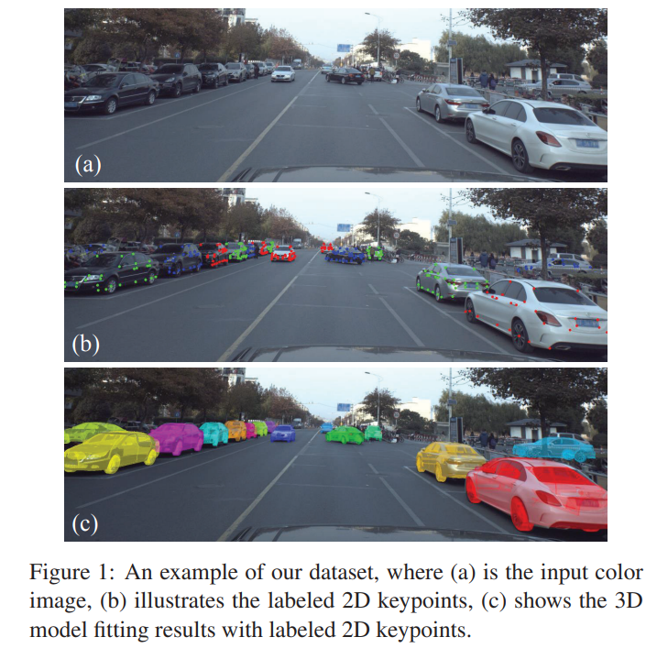
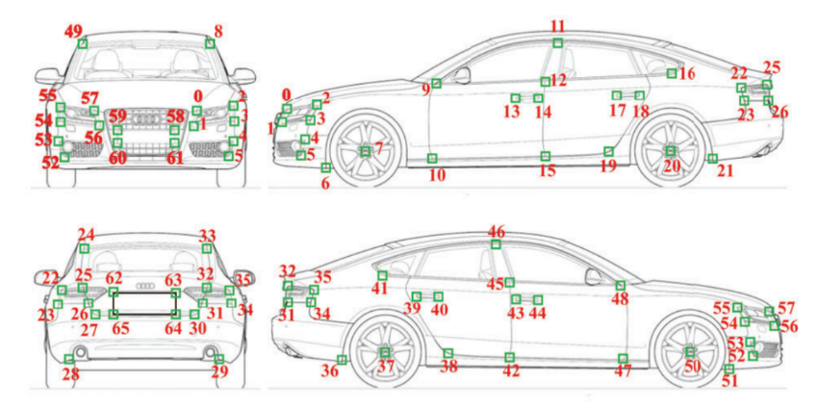
Step 2 - Car pose estimation Dataset used on Keypoint R-CNN
Apollo Dataset | Car keypoints | Image | Average cars/image | 3D Car models
 | 66 | 5277 | 11.7 | 79
The camera intrinsic parameters of all images are fixed
Labeled 2D keypoints
3D model fitting results
Notes:
There are 5277 images in Apollo dataset. Each image has 66 labeled keypoints and 79 3D car models. The camera intrinsic parameters of all images are fixed
The first is the original image, from second picture we can find many labeld 2D keypoints, here is the rule of annotations. We can see that Every keypoint has a specific class. The third picture is the 3D model fitting result.

Slide 10
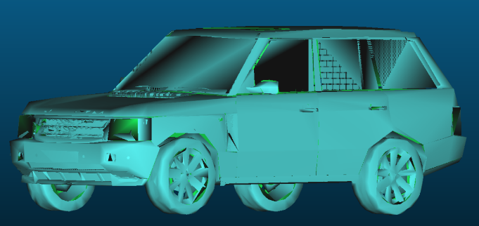
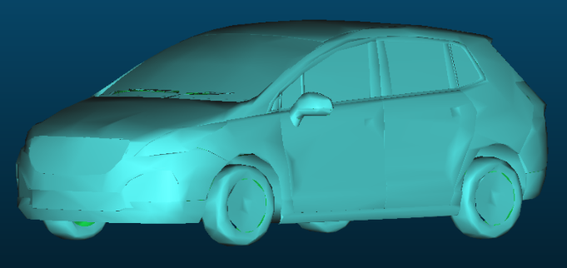
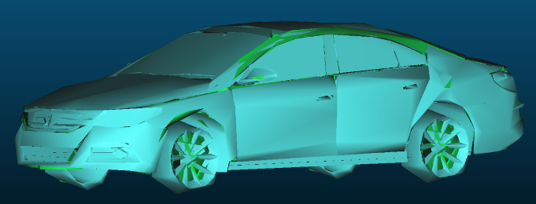
Step 2 - Car pose estimation Dataset used on Keypoint R-CNN
Category | Number
SUV | 29
Hatchback | 15
Sedan | 35
SUV
Hatchback
79 different 3D car models
…
Sedan
Notes:
The Apollo dataset provides us 79 different 3D car models. There are three representative classes are SUV , Hatchback and Sedan.

Slide 11
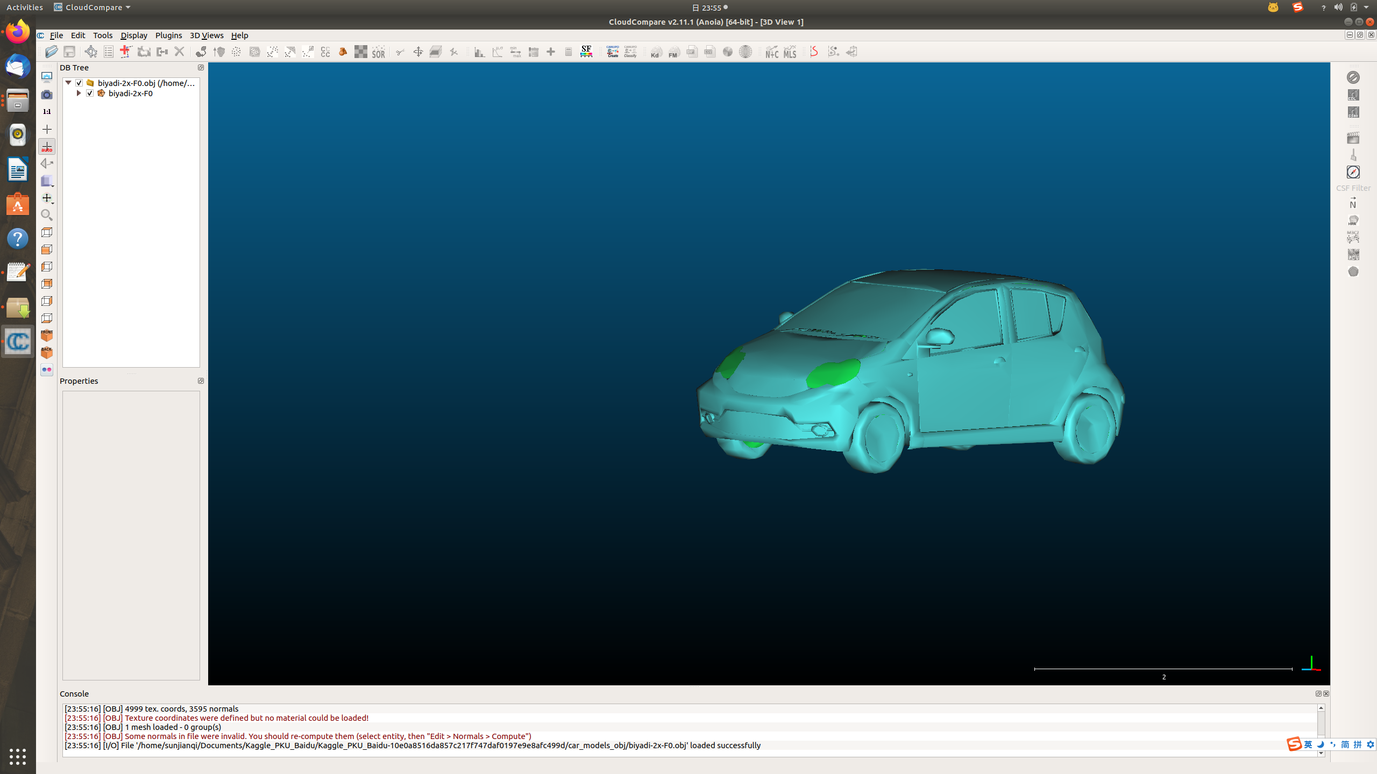
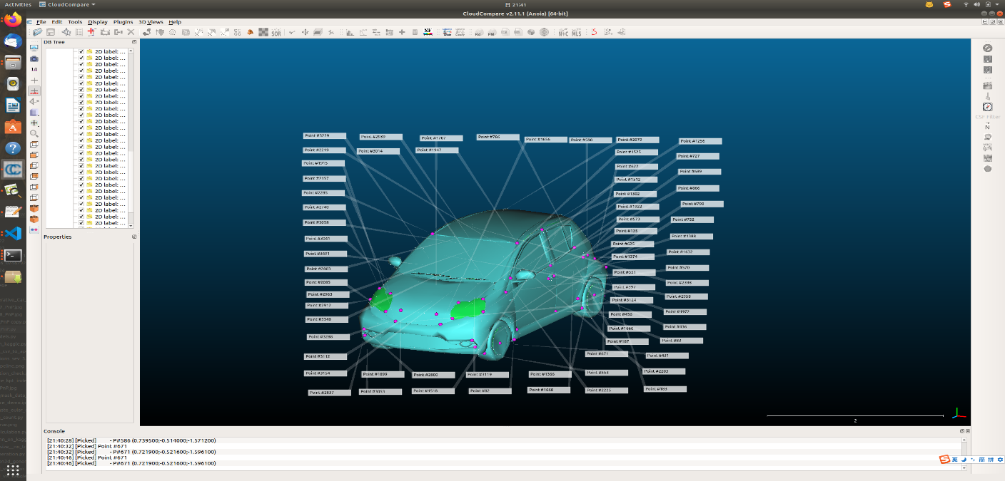
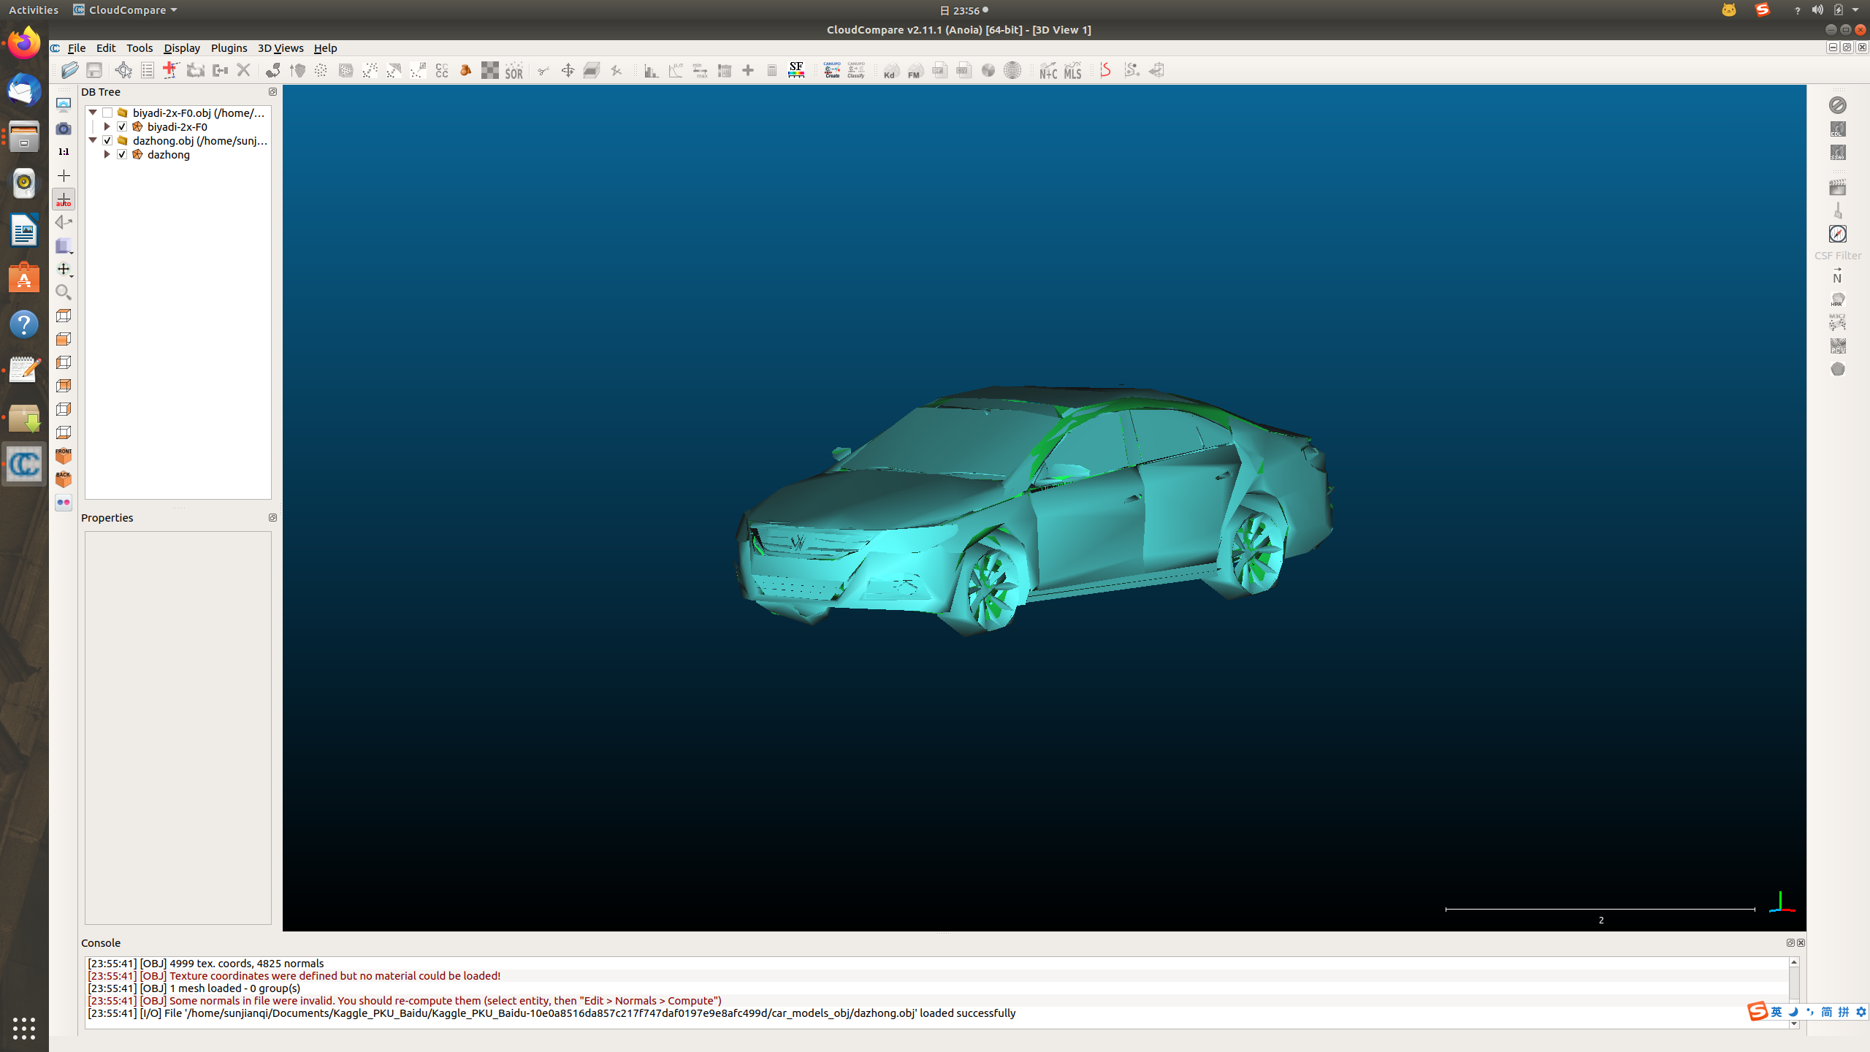
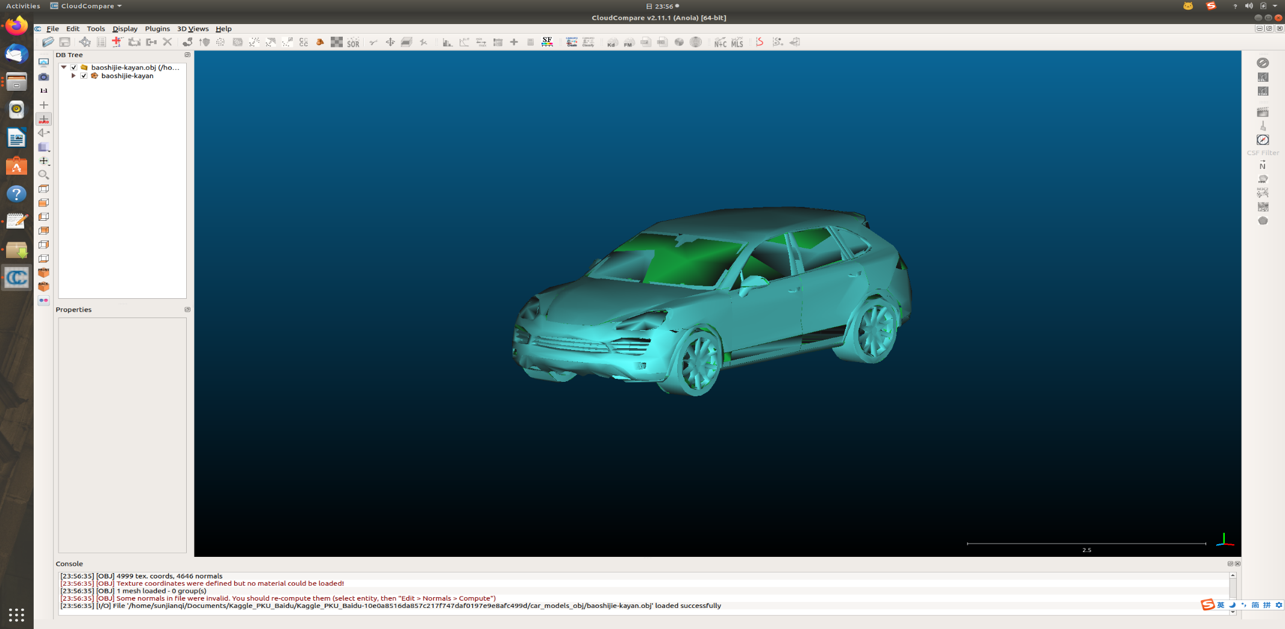
Step 2 - Car pose estimation 3D model used on PnP
Corresponding to the 66 keypoints of 2D labeling
Notes:
I selected one car from each class for 3D key point annotation. The annotation rules for key points are the same as those for 2D key points. Therefore, if the 2D keypoint information can be obtained, the corresponding 3D keypoints can also be obtained. They can be the inputs of PnP solver.

Slide 12
Step 2 - Car pose estimation Car keypoints & PnP
Keypoint R-CNN
Points in 2D image
Manual annotation
PnP
Pose
Corresponding 3D points in the world
Method | N Points required | Advantages | Disadvantages
DLT | ≥6 | Camera intrinsic is not required | Noise-free keypoints is required
DLT + LM (Iterative) | ≥6 | Noise is allowed | Camera intrinsic is required
EPNP | ≥4 | Noise is allowed Less keypoints are input | Camera intrinsic is required
PnP methods:
Notes:
In this thesis, keypointrcnn is used to detect keypoints. 2D keypoints and 3D keypoints are input to the PnP solver to obtain pose information. There are 3 PnP methods I tried to use. DLT, DLT with LM Optimization algorithm, EPNP. The first method is to obtain the camera intrinsic parameters and pose information directly after inputting at least 6 keypoints. The advantage is that camera intrinsic is not required. But it require the noise-free keypoints. The second and third methods are direct calls to the OpenCV API. The second one is an iterative method, first use DLT to get initial value, and then use LM algorithm to optimize the result. It should be noted that although this method also uses DLT, it also requires the input of fixed camera intrinsic parameters. That is, the optimization process will only optimize the values of translation and rotation. EPNP method require only 4 keypoints. Both Iterative method and EPNP allow the keypoint noise. But camera intrinsic is required.

Slide 13
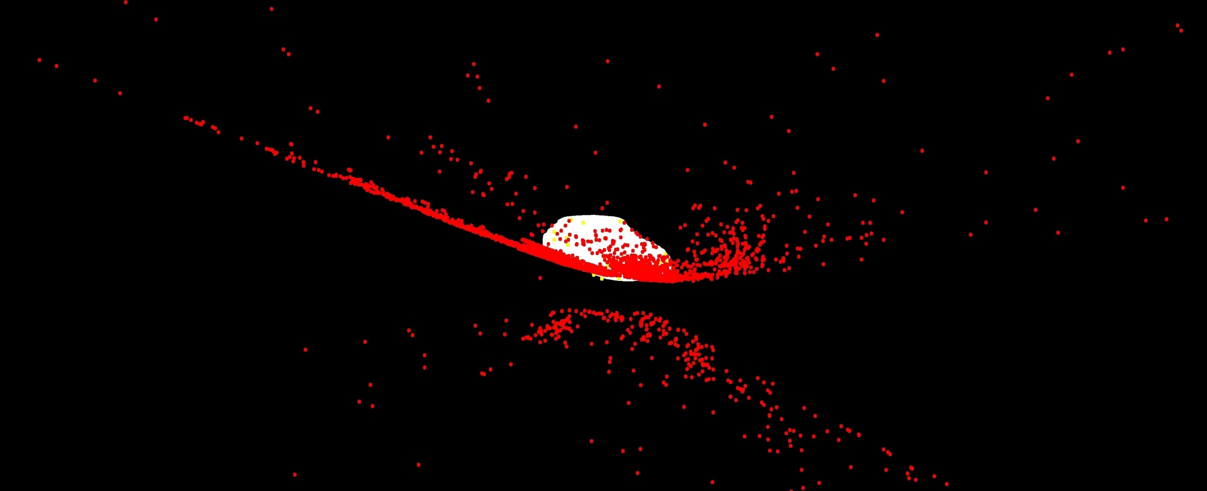
Step 2 - Car pose estimation PnP - DLT
The method of DLT requires noise-free points
Red points: the projection of the vertices of the 3D model
Notes:
Here is an experiment of DLT method. Our method cannot provide noise-free key points. Solving the camera intrinsic parameters, translation and rotation by DLT after projection does not give correct results.

Slide 14
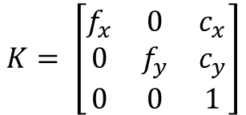
Step 2 - Car pose estimation PnP – ITERATIVE & EPNP
Required:
Camera intrinsic parameters (Fake)
2D keypoints (Mask R-CNN)
Corresponding 3D keypoints (Manual annotation)
Fake camera intrinsic parameters are required
$$K= \left[\begin{matrix}f_{x} & 0 & c_{x} \\ 0 & f_{y} & c_{y} \\ 0 & 0 & 1\end{matrix}\right]$$
K: Camera intrinsic
F: Focal length -> the scale of the distance
C: Principal point -> the offset between the image center and the projection center
Notes:
So the camera intrinsic parameters, 2D and 3D keypoints are required for PnP solver. The main parts of the camera intrinsic parameters are the focal lengths fx and fy, and the principal point (cx, cy). Focal length affects the scale of the distance between camera and 3D model. The principal point affect the offset between the image center and the projection center. When this information cannot be obtained, it is impossible to get the object’s exact position in the 3D coordinate system. If we do not need to obtain the exact position, but only need to focus on whether the 3D model can be accurately projected onto the 2D image, we can use the fake camera intrinsic parameters. This is why it is possible to use fake camera intrinsic parameters in our method.
In order to solve the problem of not being able to get the camera intrinsic parameters for every image, the fake camera intrinsic parameters are needed. If the size of the input image is the same as the size of the image in the Apollo dataset, the size and position of the object in the input image are also close to the size and position of the object in the Apollo dataset. Then these fake camera intrinsic parameters can be near to those in the Apollo dataset. The translation and rotation vectors obtained by the PnP solver deviate from the actual ones if fake camera intrinsic parameters are used. However, the goal of this thesis is not to obtain the exact pose from camera to 3D model. We need the 3D model can accurately be projected onto the image. We can achieve this goal if using the fake camera intrinsic.

Slide 15
Step 2 - Car pose estimation Training of Keypoint R-CNN
Training Strategies
Pretrained model from GSNet, M1
ApolloCar 3D dataset, D1, T1
Retrained model with 3 output classes, M2
D1 after mean filtering, D2, T2
Retrained model that can be applied at different resolutions, M3
D2 for simulated flooding, D3, T3
Retrained model that can be applied at flood scenario, M4
Notes:
This part is about the training strategy of Keypoint RCNN model. Since our method uses the same network and dataset as GSNet mentioned before. Therefore, GSnet's model is used as our pre-trained model. The Apollo dataset class labels are first converted from 79 classes to 3 classes. Fine-tune the original model with the Apollo dataset. The new model will ouput 3 classes. The purpose to do this is that we only manually labeled 3 different classes of 3D models. So we only need to know which of these 3 classes the car in the image belongs to.

Slide 16
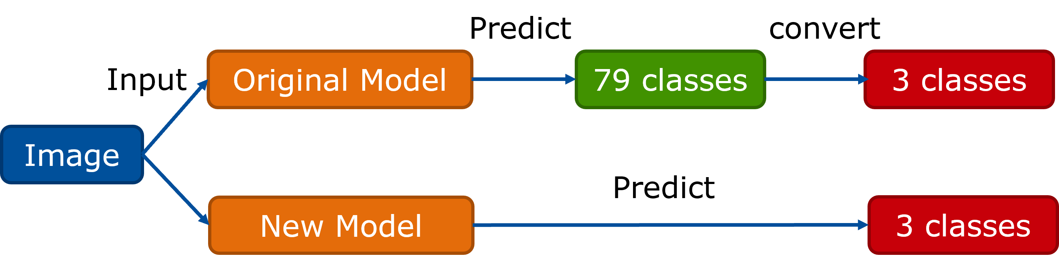
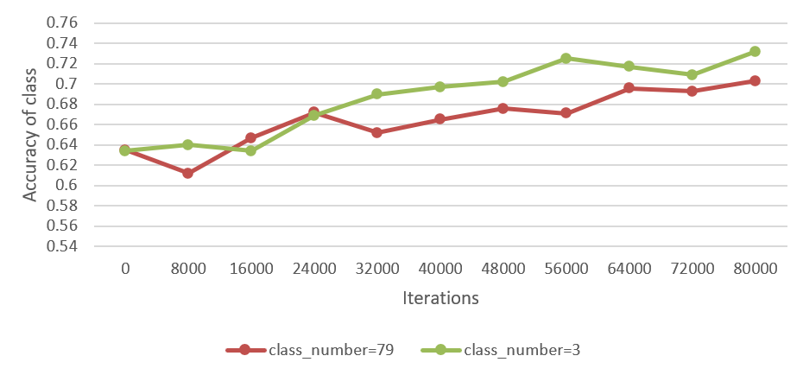
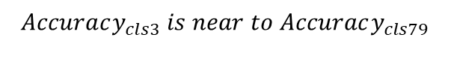
Step 2 - Car pose estimation Training of Keypoint R-CNN
$$Accuracy_{cls3} is near to Accuracy_{cls79}$$
Notes:
During the mid term presentation, Prof. Seste asked whether it would be better to directly let the model output the 3 classes. So I did the following experiment.
If it is the original model, 79 classes will be output first. We convert the output classes into the corresponding 3 classes and calculate the class accuracy. Alternatively, using the new model, we directly output 3 classses and calculate the class accuracy. First, the accuracy of the new model is trained to be near to the accuracy of the original model. Next, the class accuracy is calculated at different numbers of iterations using 500 test images. From the result, it can be seen that the accuracy of the new model is better than that of the original model. The model with iteration number 56000 is chosen as the new model, M2.

Slide 17
Step 2 - Car pose estimation Training of Keypoint R-CNN
Training Strategies
Pretrained model from GSNet, M1
ApolloCar 3D dataset, D1, T1
Retrained model with 3 output classes, M2
D1 after mean filtering, D2, T2
Retrained model that can be applied at different resolutions, M3
D2 for simulated flooding, D3, T3
Retrained model that can be applied at flood scenario, M4
Notes:
One Data augmentation method mean filter is used for data set D1. The window size of the mean filtering is randomized. The purpose of this operation is to adapt the model to image inputs of different resolutions. The test set is also processed in the same way, generate T2.

Slide 18
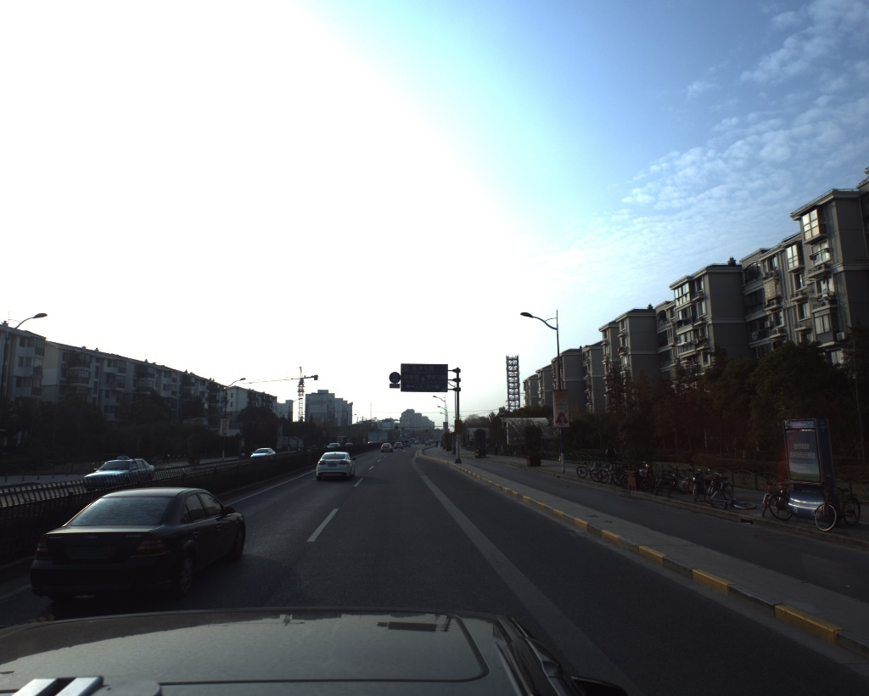

Step 2 - Car pose estimation Training of Keypoint R-CNN
Data Augmentation – mean filter
Before mean filtering
After mean filtering
Notes:
We can see that the left image is the original image and the right one is the image after mean filtering.

Slide 19
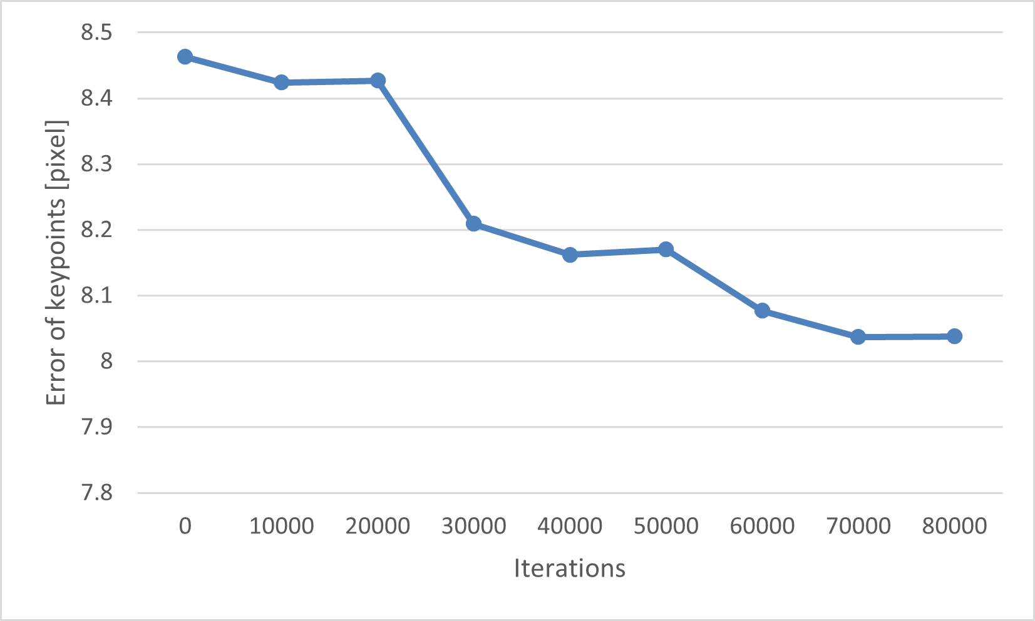
Step 2 - Car pose estimation Training of Keypoint R-CNN
Fine-tuning of the M2 model using D2.
Get the result using Test Dataset T2 (500 images).
Notes:
We fine tune the model M2 using dataset D2, and get the result using Test Dataset T2. It include 500 images. As the number of iterations increases, the key point error decreases. We choose an iteration number of 70000 as the new model, M3.

Slide 20
Step 2 - Car pose estimation Training of Keypoint R-CNN
Training Strategies
Pretrained model from GSNet, M1
ApolloCar 3D dataset, D1, T1
Retrained model with 3 output classes, M2
D1 after mean filtering, D2, T2
Retrained model that can be applied at different resolutions, M3
D2 for simulated flooding, D3, T3
Retrained model that can be applied at flood scenario, M4
Notes:
The final step is to fine-tune M3 with a dataset of simulated floods to make the model perform better in detecting cars in floods.

Slide 21

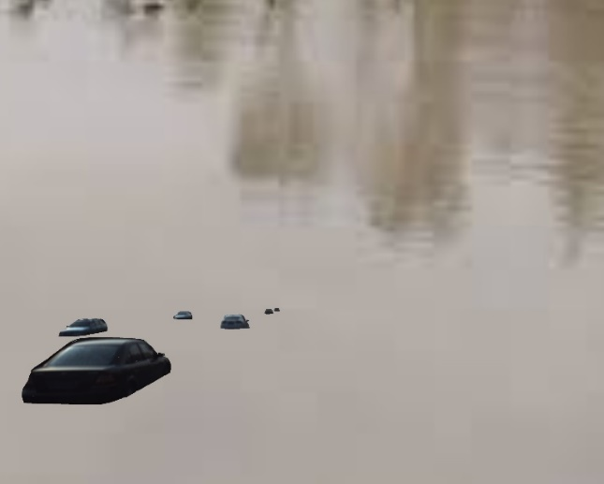
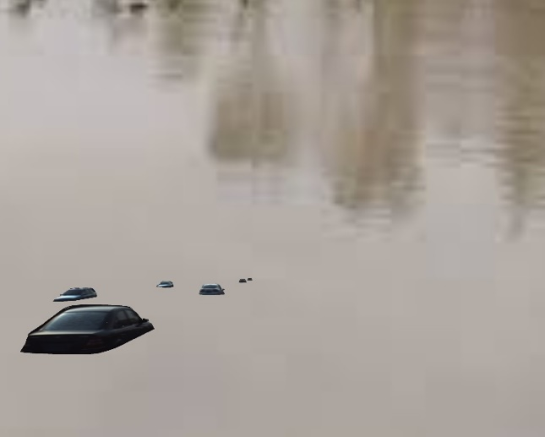
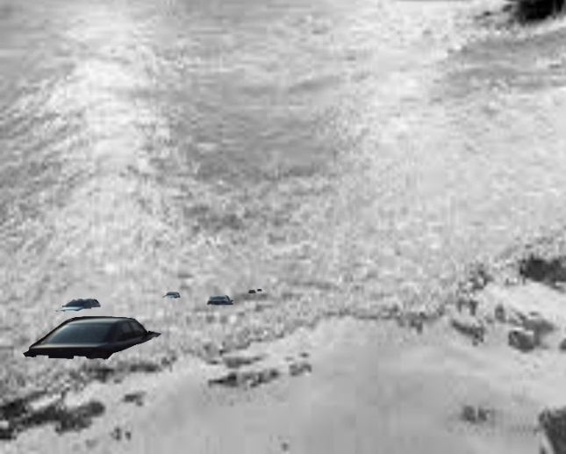
Step 2 - Car pose estimation Training of Keypoint R-CNN
Data Augmentation – Flood scenario simulation
Original image
Water level = 0.4m
Water level = 0.6m
Water level = 0.8m
Notes:
Different simulations of the car in different water depths are shown here.

Slide 22
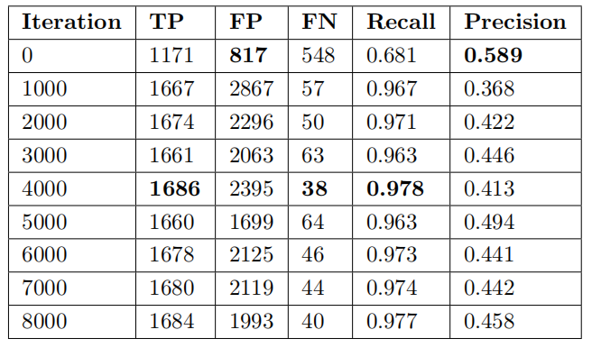
Step 2 - Car pose estimation Training of Keypoint R-CNN
Car detection results using Test Dataset T3 (500 images)
Calculate the IoU of the bounding box of the prediction and ground truth, if the IoU is greater than 0.5, then the match is successful.
Notes:
Here shows the car detection results using test dataset T3. TP represents the bounding box of the ground truth and the prediction can be matched. Calculate the IoU of the bounding box of the prediction and ground truth, if the IoU is greater than 0.5, then the match is successful.
The results show that Recall keeps increasing when the number of iterations is not greater than 4000, which means that the model can detect more cars correctly. However, the precision keeps decreasing as the number of iterations increases. This means that the number of false detections in an image increases. These false detections will be filtered out in the next steps.

Slide 23
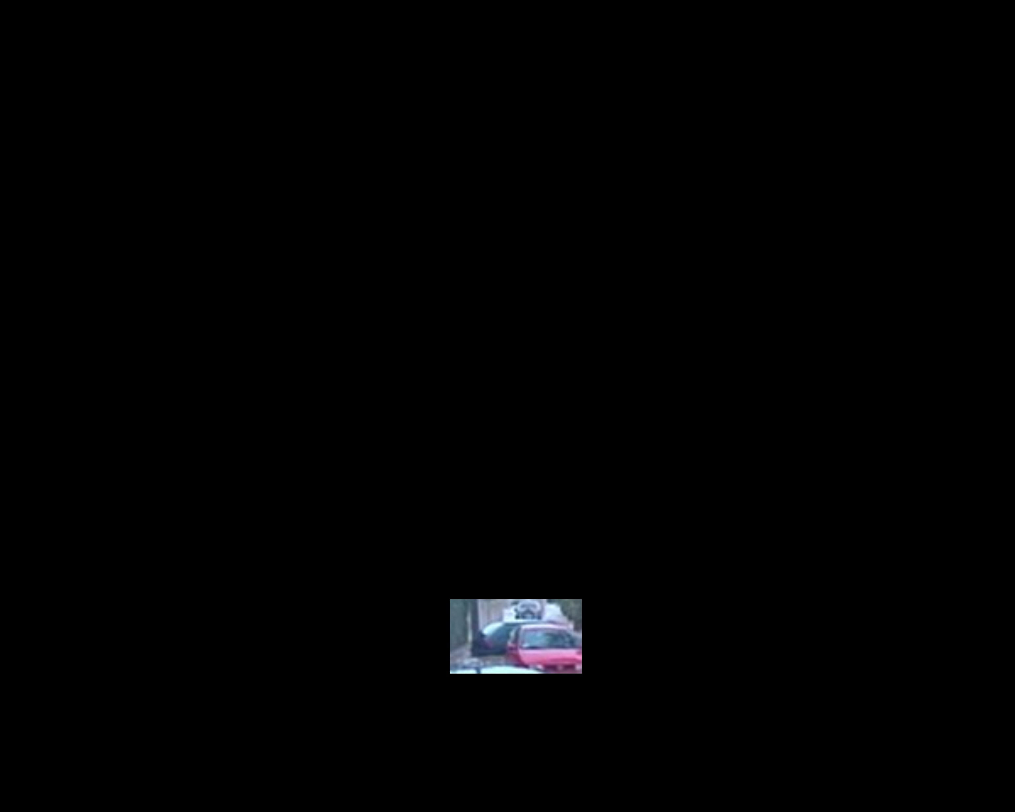
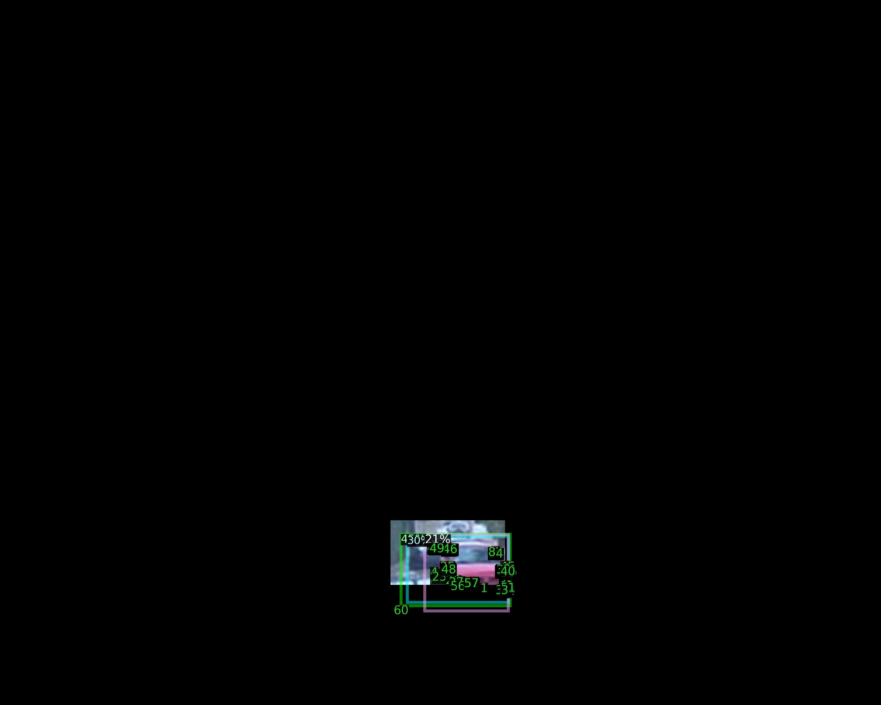
Step 2 - Car pose estimation Training of Keypoint R-CNN
Before retraining
After retraining
Notes:
Here is the result after retraining the model, From the comparison, it can be seen that the model's ability to detect cars in flood has improved after retraining.

Slide 24
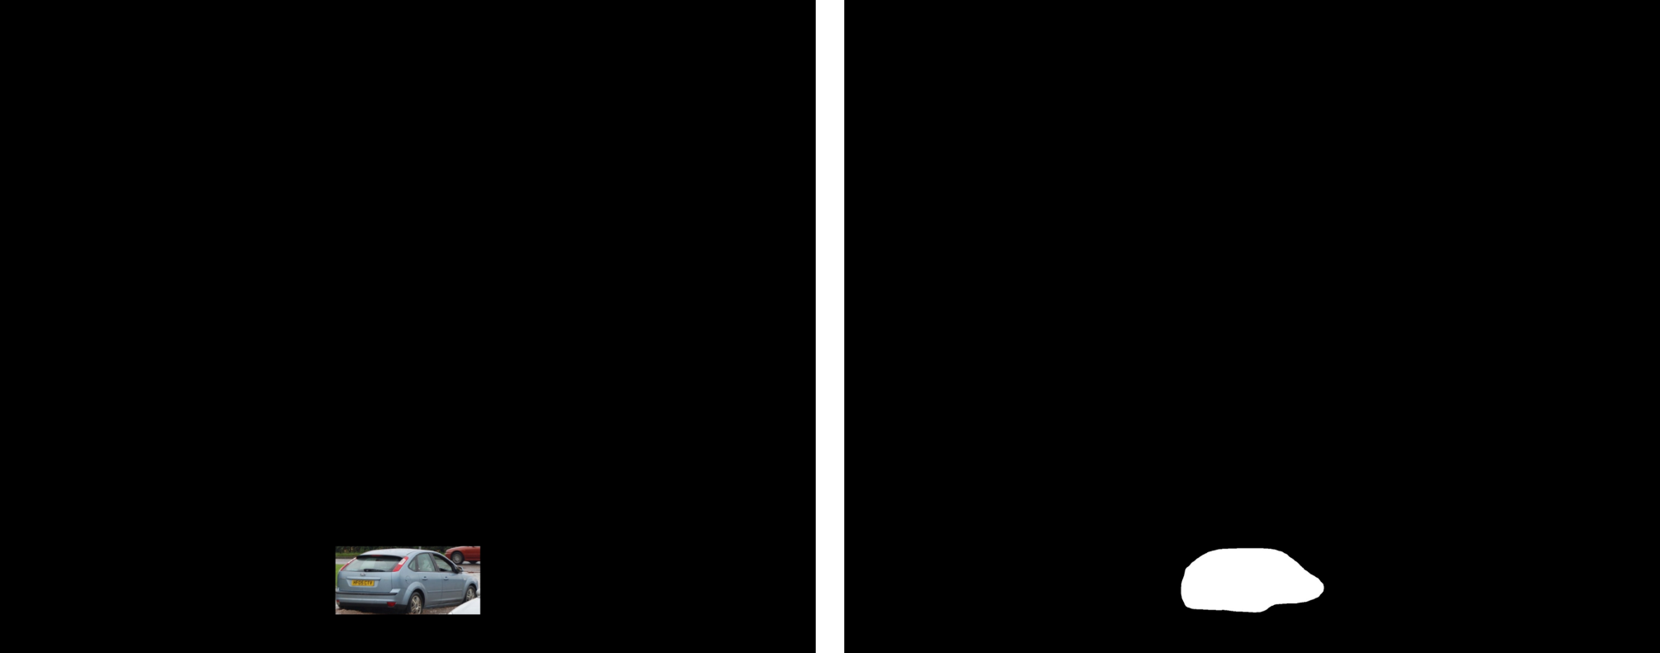
Step 2 - Car pose estimation The input of Keypoint R-CNN
Rescaled to the common size of cars in the KeypointRCNN dataset.
Notes:
After the model is retrained, we input the new images into the model. As said before, we use a fake camera internal reference. In order to make the fake camera intrinsic parameters close to the real situation, the input images need to be resized to the same size as the images in the Apollo dataset. Also, each car needs to be resized to the size that the model detects best.

Slide 25
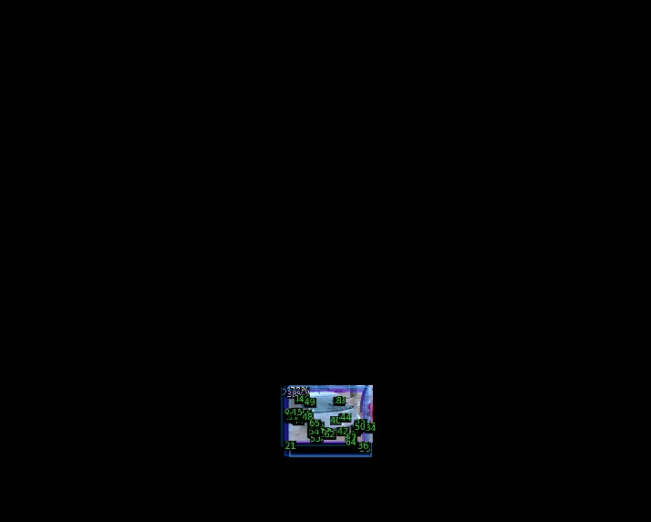
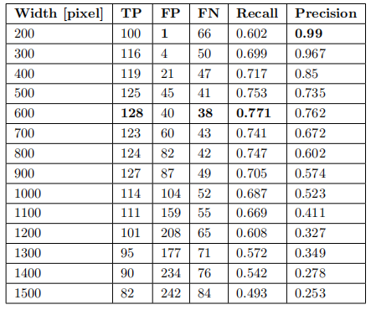
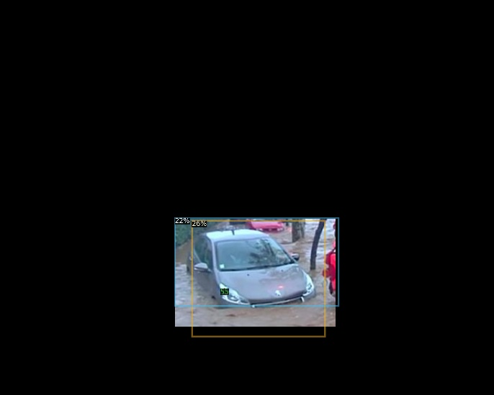
Step 2 - Car pose estimation Rescale the instance
Select different sizes of instance width
Width = 400px
Width = 1000px
Notes:
As can be seen from the table, We use cars with actual flood scenarios as the test set. when the width of the instance is not greater than 600, Recall increases as the width increases. In other words, the number of missed detections decreases. As the size increases, Precison decreases, which means that the number of false detections increases. However, the false detections are filtered out in the next steps, so we pay more attention to Recall. Therefore, we choose the width of 600 pixels.

Slide 26
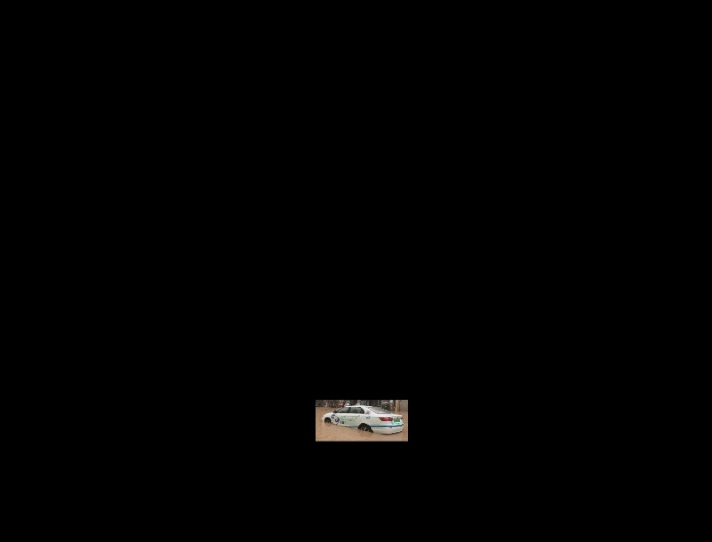
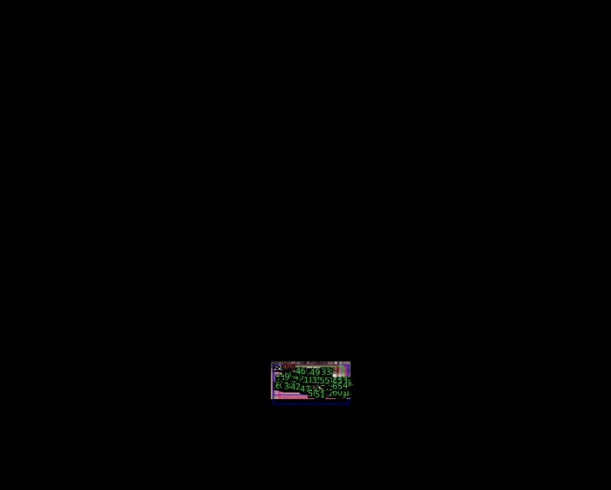
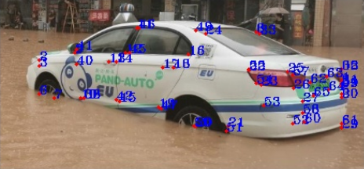
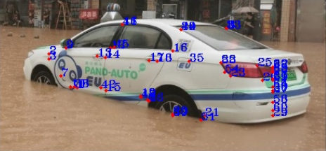
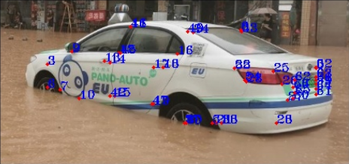
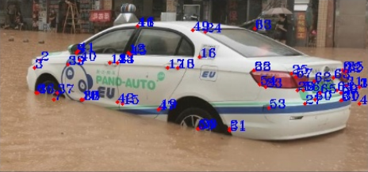
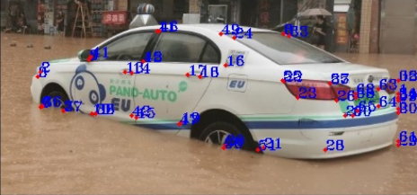
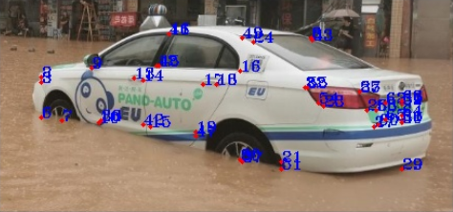
Step 2 - Car pose estimation Keypoints Detection
KeypointRCNN
Candidate 1
Candidate 2
Candidate 3
Candidate 4
Candidate 5
Candidate 6
Notes:
Then we input the resized images to KeypointRcnn, and finally obtain different candidates. Maybe some candiates are false detections. What we need to do is to select the optimal one from these candidates.

Slide 28

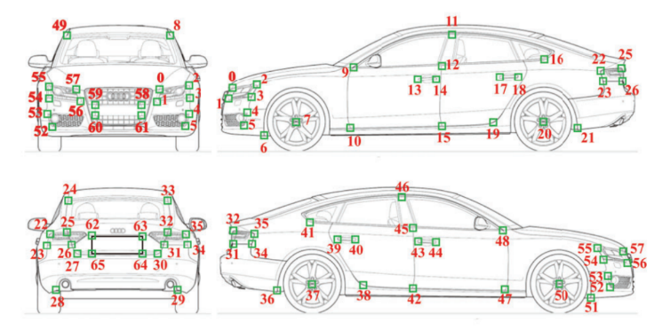

Step 2 - Car pose estimation Keypoints Detection
Before filtering
After filtering
Notes:
As shown in the picture, these keypoints are directly output by the model. Many classes of key points are wrong. For example 49 and 8 belongs to front side, 51 belong to the point near to front wheel. If we use these wrong keypoints to do PnP, we will get bad results. Therefore, keypoints need to be filtered before using them for pnp.

Slide 29


Step 2 - Car pose estimation Keypoints Detection
Keypoint Filtering
Notes:
As shown in the picture, these keypoints are directly output by the model. Many classes of key points are wrong. For example 49 and 8 belongs to front side, 51 belong to the point near to front wheel. If we use these wrong keypoints to do PnP, we will get bad results. Therefore, keypoints need to be filtered before using them for pnp.

Slide 30

Step 2 - Car pose estimation Keypoints Detection
Keypoint Filtering
Repeated points on the left and right sides are removed
Notes:
The key points output from the model is judged belonging to which side. Select the one with the most key points on the front and back side, and do the same for the left and right side. Since there are some points appearing on both sides, these points are removed from the left and right sides.

Slide 31


Step 2 - Car pose estimation Keypoints Detection
Before filtering
After filtering
Notes:
For example, in this pair of picture, there are more points belonging to the left and the back than the right and the front. Therefore, we can judge that this car is facing us from the back and left side. Then filter out the points that do not belong to the back and left side. This picture is the effect after filtering.

Slide 32



Step 2 - Car pose estimation PnP (Perspective-n-Points)
PnP process
6DoF Pose Information(Translation and rotation vector)
reproject
Notes:
Now, we get 2D keypoints and the correspoing class 3D keypoints, after pnp we can calculate pose.

Slide 33
Step 2 - Car pose estimation PnP (Perspective-n-Points)
Input:
Keypoints of each candidate after filtering
The fake camera intrinsic parameters
Class of the candidate
Output:
Pose information (translation and rotation)
Steps:
Iterate -> each candidate.
Randomly select 12 keypoints.
Input to PnP solver <- fake camera intrinsic parameters, 2D keypoints and corresponding 3D keypoints (get pose)
Calculate the average error of all 2D keypoints and the points projected from corresponding 3D keypoints onto the image.
Cycle 2-4 steps 200 times to find out the pose corresponding to the minimum error.
Obtain the pose information of each candidate.
Notes:
Here is the detail of pose estiamtion.
Iterate through each candidate.
Randomly select 12 keypoints from the current candidate.
Input the fake camera intrinsic parameters, 2D keypoints and corresponding 3D keypoints into the PnP solver to get the pose information.
Calculate the average error of all 2D keypoints and the points projected from corresponding 3D keypoints onto the image.
Cycle from the second to fourth steps 200 times to find out the pose corresponding to the minimum error.
Obtain the pose information of each candidate.

Slide 34






Step 3 – Water Level Estimation
Find the best matched candidate by IOU
Candidate with maximum IOU
Notes:
Then The 3D model is projected onto the 2D image by the obtained pose information for each candidate. Calculate the IOU between the projected mask and the mask generated by maskrcnn. The candidate with the best match is selected by max IOU.

Slide 35





Step 3 – Water Level Estimation
30cm
20cm
10cm
1cm
0cm
Water Level: 0cm
Water Level: 10cm
Water Level: 20cm
Water Level: 30cm
Notes:
The final step is to calculate the water level, The overall idea is to estimate the water depth by changing the 3D model and calculating the IOU of the mask generated with Maskrcnn. In the initial state, the water level is 0. These are the two MASKS in the initial state. In each iteration, the water level was raised /’reizd’/ by 1 cm. If IOU is increased, then continue, after 10 interations, the water level up to 10 cm, these are the two masks. You can see that the lowest position has been lifted. After 20 iterations, the wate level up to 20cm, and IOU is still increased. After water level up to 30cm, Iou starts to decrease, and determine the water level at 30cm.

Slide 36




Experiments Dataset for experiments
Manual labeled dataset from ETHZ (Chaudhary et al., 2019)
In many cases, our results achieved more reasonable estimation
Ours
Label
Ours
Label
Radius:
～12.5inch = 31.75cm
Notes:
This part is about experiments. I compared our results with the labels of the dataset ETHZ. It turns out that our results are more reasonable. as you can see from the picture the height of the water level is more than the radius of the wheel. Level3 corresponds to a range of 10cm to 21cm, and our results is 36cm. The radius of the wheel is about 32 cm, thus indicating that our results are more accurate.
For the second figure, after measurement, 80cm is reasonable, indicating that we can give more accurate results.

Slide 37

Experiments Dataset annotation
Manual labeled dataset by myself
Notes:
Therefore, I manually labeled 100 images of the car. Finding the position of the water level on the images on the 3D model. Then get information about the water depth.

Slide 38

Experiments Comparision of Different PnP Methods
The effect of 2 PnP methods with different input keypoint number on the average difference.
$$D= \sum_{i=1}^{n}{\left(\left|d_{p}−d_{g}\right|\right)}$$
Notes:
Here shows the effect of 2 PnP methods with different input keypoint number on the average difference. I Use the labeled 100 images as the test set. There are 166 car instances in the test dataset. Calculate the difference between the estimated water level and the ground truth for each instance. The average of the absolute value of the difference is finally obtained as the evaluation matrix. When the number of input key points is less than 7, the difference of EPNP is smaller than the difference of Iterative. When the number of key points is greater than 7, the ITERATIVE method is better than EPNP, and when the number of key points is greater than 12, the error starts to increase. Therefore, choosing ITERATIVE's method and inputting 12 key points will output the best result.

Slide 39
Experiments Comparision of Different PnP Methods
The effect of 2 PnP methods with different input keypoints on the number of matched object number.
Notes:
As you can see from this graph, as the number of key points increases, the number of detected objects decreases. This is because as the number of keypoints increases, the filtering conditions become stricter, and if the number of keypoints detected for an instance is less than the number of input keypoints, no valid results will be output.

Slide 40


Experiments Evaluation of water level estimation
The average difference of water level with the best model is 0.137m
Histogram of water level average difference distribution
Notes:
Using the final model with 12 key points input into the PnP solver, the average difference of water level estimation is 0.137m. This achieves decimeter-level accuracy. I counted the water levels of the labels according to different ranges. The table shows that the highest accuracy is achieved when the car is at a water level between 0.4 and 0.6 meter. One reason is when the water level is very small, when a car passes by, it will stir up a big splash, which will cause the Maskrcnn to extract the mask inaccurately. Next is the histogram of water level average difference distribution. We can see that the difference is mostly between 0 and 20 cm. This also shows that the robustness of this method is good.

Slide 41

Final Output
Water level estimation in the same situation
Notes:
As shown in the picture, green line is the edge of the fitted 3D model and blue line is the edge extracted by maskrcnn. The closer the edges of the two lines, the more accurate the estimation results. It can be seen from the picture that the predicted water depth is close to ground truth. And these two vehicles are at the same water depth, which proves the high robustness of our proposed method.

Slide 42

Final Output
Water level estimation in the same situation
加箭头
Notes:
This picture also shows the water level estimation in the same scenario.

Slide 43



Final Output
The method is applicable to water level estimation from different perspectives.
Notes:
In different perspectives, our method can output accurate results. This is applied to the geometric relationship of the 3D model, which has more accurate results than other image-based water level estimation methods.

Slide 44

Final Output
The car is not in the flood
Notes:
This is the scene when the car is not in the flood, and the result is only 6 cm error.

Slide 45


Final Output
The car is in very deep flood water
Notes:
This is the scene when the car is in a very deep flood and the results are still accurate.

Slide 46

Final Output
When the water is very shallow, the car passing by will stir up water splashes and lead to wrong results.
Notes:
When the water is very shallow, the car passing by will stir up water splashes and lead to wrong results.

Slide 47

Final Output
The occlusions caused by other objects
Notes:
In this picture, the 3 cars in the further distance are occluded by the nearer cars, leading to incorrect estimation results.

Slide 48



Final Output
Wrong pose estimation and class
Notes:
When the results of the pose estimation are wrong, the 3D model is incorrectly projected onto the 2D image, which leads to wrong water level estimation results. Similarly, the use of 3D models with different class still leads to significant difference in the results due to incorrect class detection.

Slide 49
Summary
Advantages:
Suitable for images from different cameras/sources (camera intrinsic parameters less important)
Suitable for images of any resolution
Provides a greater range of estimated water levels than the method of some method like only detecting wheels
Water level estimation based on 3D models, more reasonable than using pixel distances on images (e.g. human body keypoints)
Car class information included, three common types considered (SUV, Sedan, Hatchback)
Disadvantages:
Strongly influenced by the performance of the keypoint quality
Not an end-to-end model, need output from two models

Slide 50
Outlook
Combine two neural networks Mask R-CNN and Keypoint R-CNN into one.
The training set currently used is obtained by simulating flood scenes, and in the future more pictures of flood scenes can be collected to train the neural network.
Label as many 3D models with large differences in appearance as possible so that the model can be fitted better to the car in the image.
Notes:
This part is about outlook. In this method, two neural networks Keypoint R-CNN and Mask R-CNN are used. if both mask and keypoint information is available in a flood dataset, it is possible to combine the two models into one model so that it outputs both masks and keypoints. Therefore, it is necessary to collect images for flood scenarios to produce dataset. The training set currently used is obtained by simulating flood scenes. There is a gap between the simulation and actual secenirio. Finally, Label as many 3D models with large differences in appearance as possible so that the model can be fitted better to the car in the image.

